Slide 1
Lesson 2
American History
A: The Colonial Period and Independence
Questions: 61, 59, 60, 87, 64
1

Slide 2
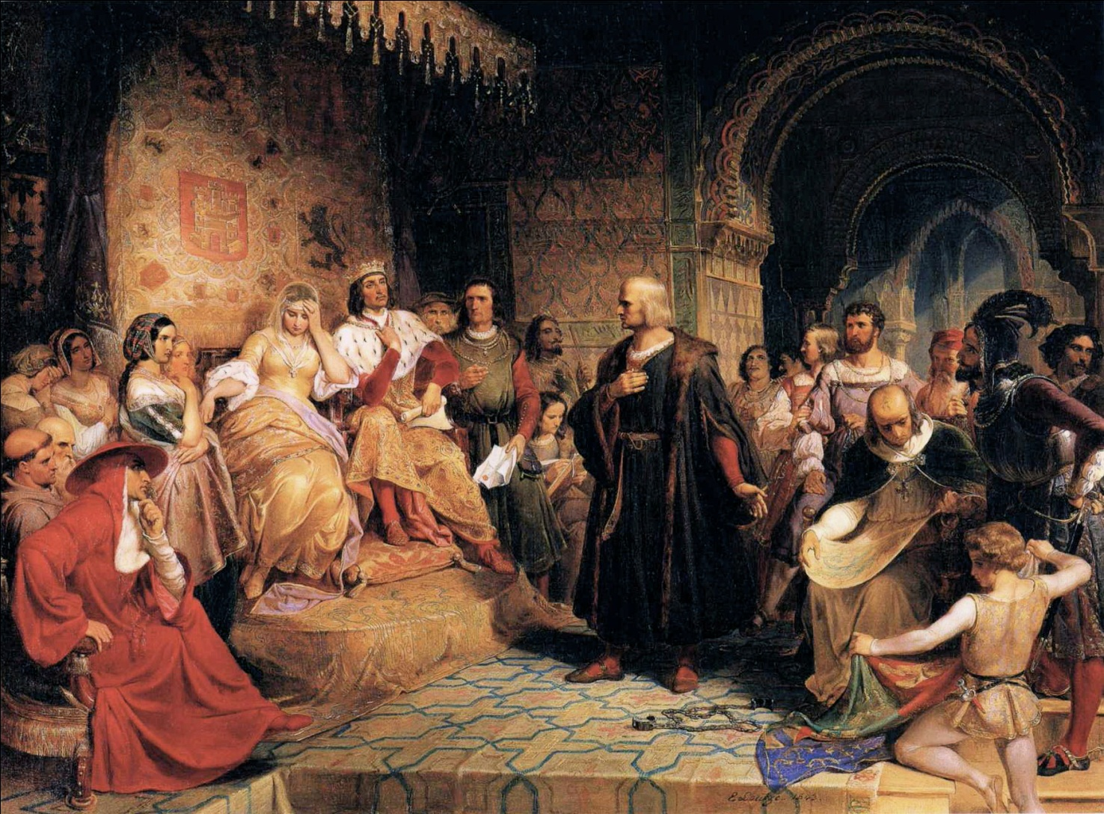
Early Explorer Christopher Columbus

Slide 3


Slide 4
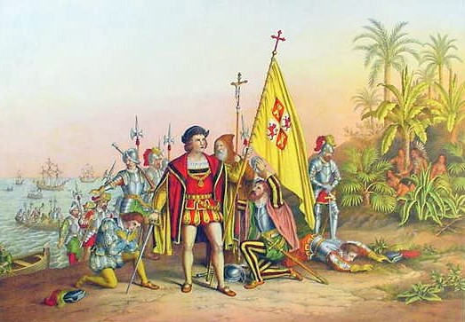

Slide 5

Question # 59

Slide 6
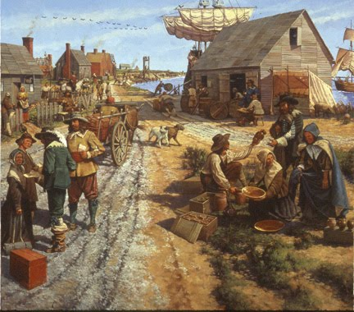
The First Colonies - 1620

Slide 7

Question # 58

Slide 8
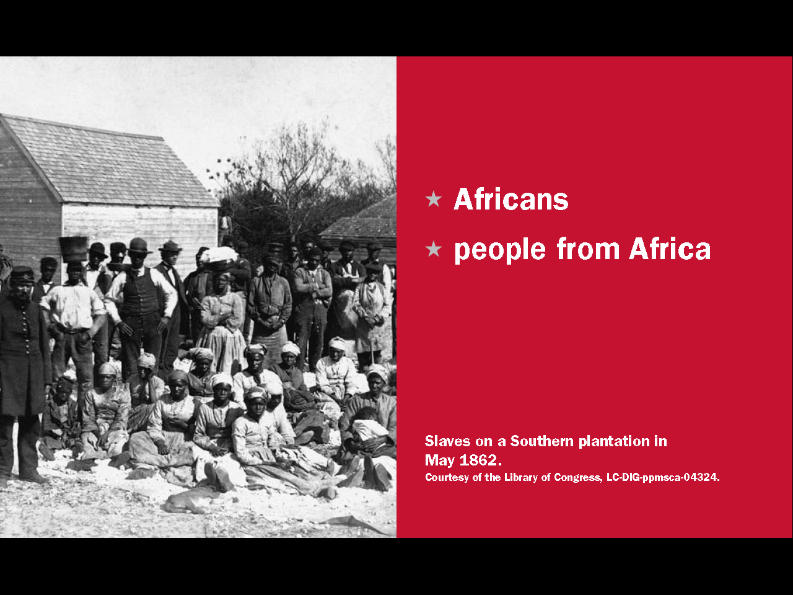
Question # 60

Slide 9
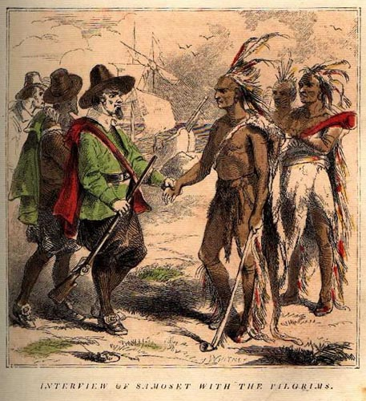
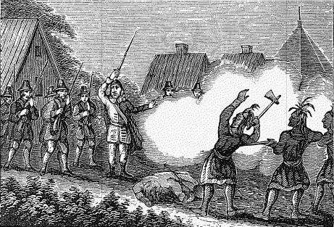
Colonists and Native Americans

Slide 10
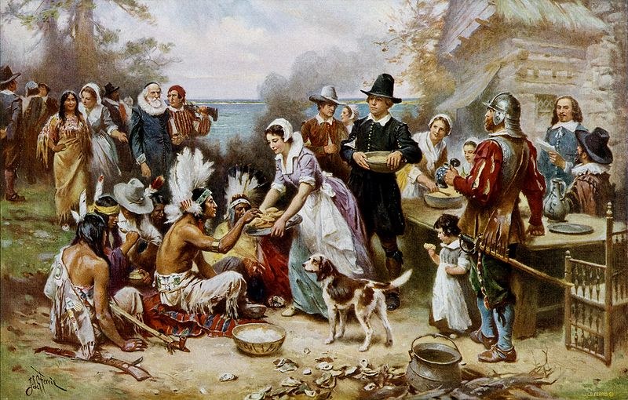
Thanksgiving

Slide 11
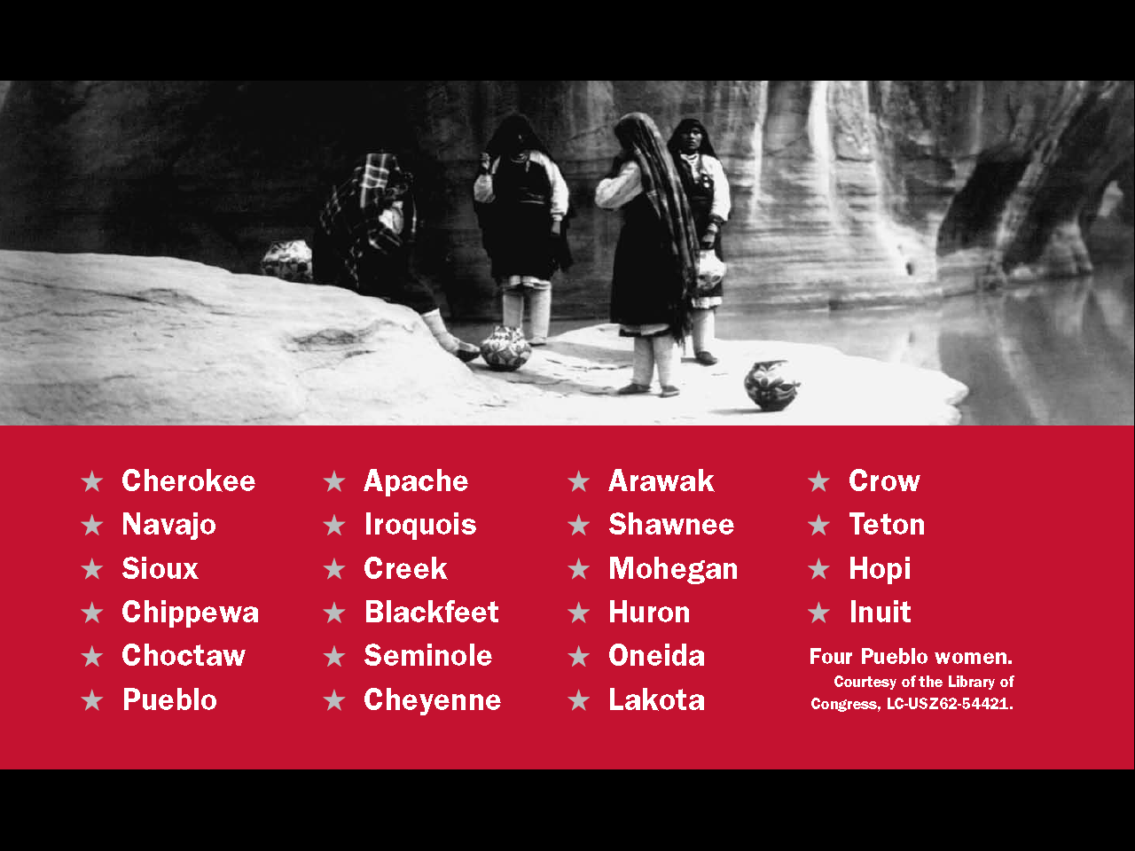
Question # 87

Slide 12
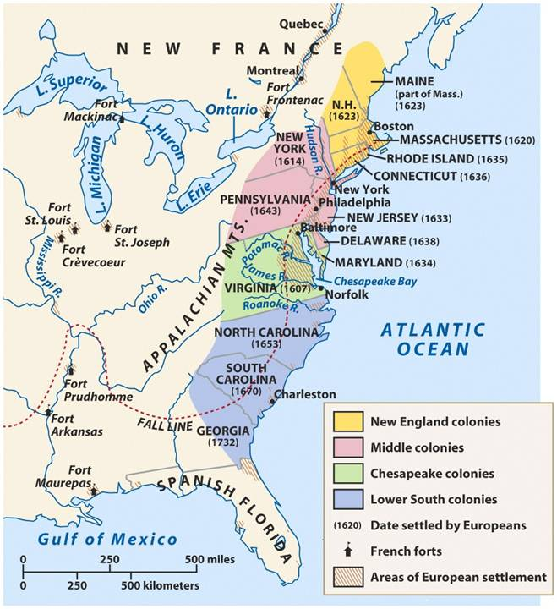

Slide 13
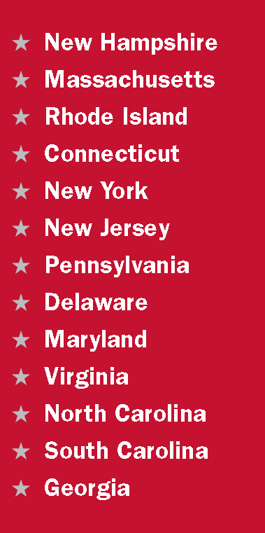

New England
Question # 64
Was part of Massachusetts

Slide 14
Lesson 2
American History
A: The Colonial Period and Independence
Questions: 61, 8, 62, 63, 9, 70, 69, 65, 68
14

Slide 15

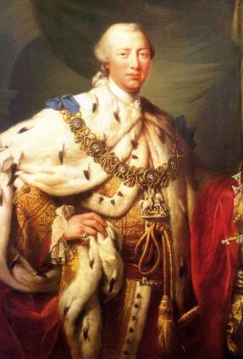
The Government of Great Britain
King George III
The Ruler of Great Britain
He Inherited all his power from his royal parents
He was not elected by the people
He did not allow American colonists to be politicians in the British Parliament.

Slide 16
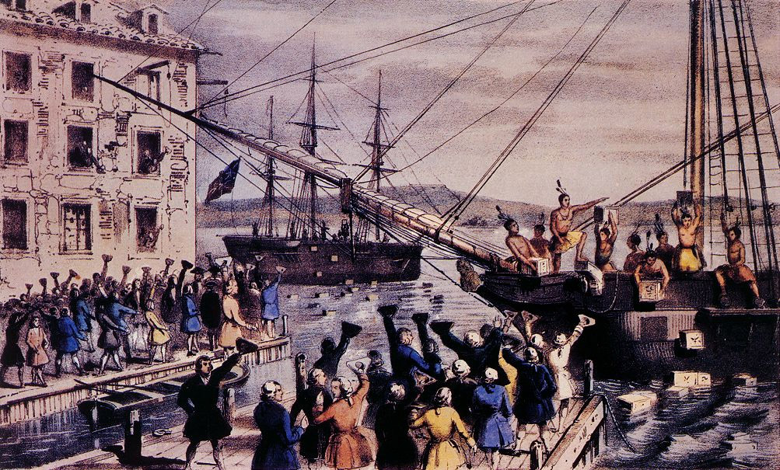
The Boston Tea Party - 1773

Slide 17
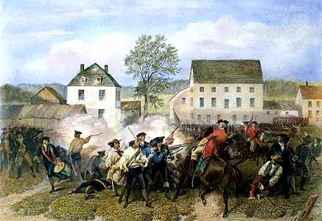
The Revolutionary War - 1775

Slide 18
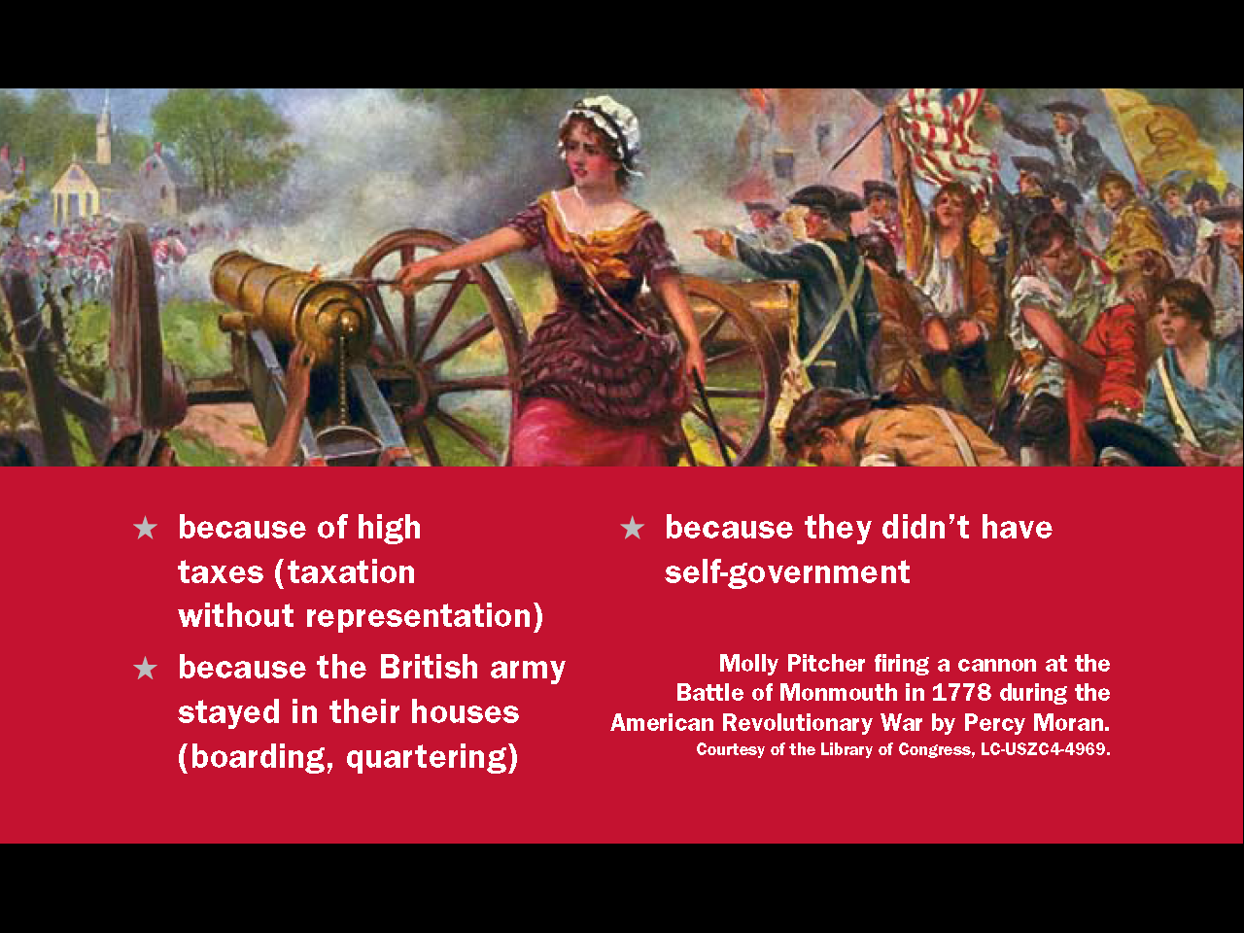
Question # 61

Slide 19
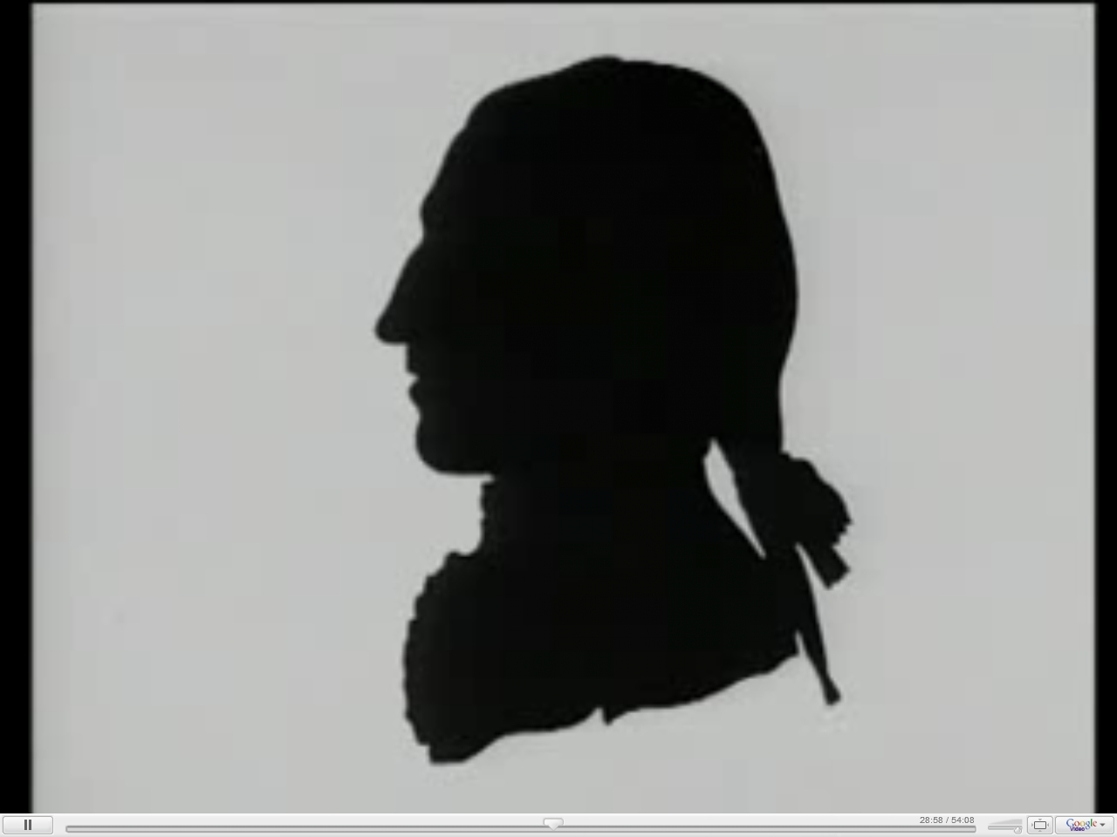

Slide 20
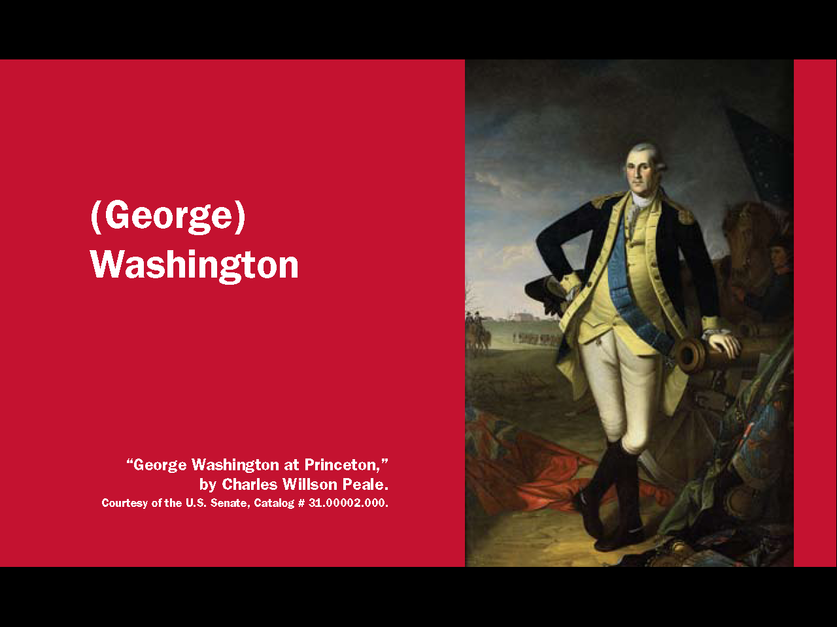
Question # 69 and 70

Slide 21
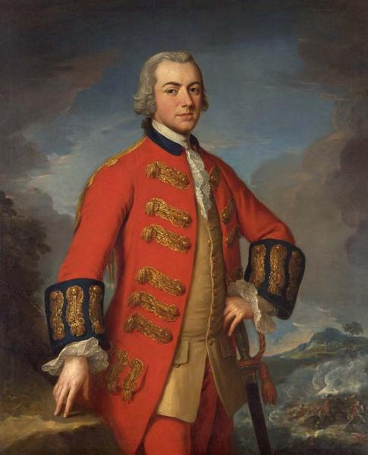
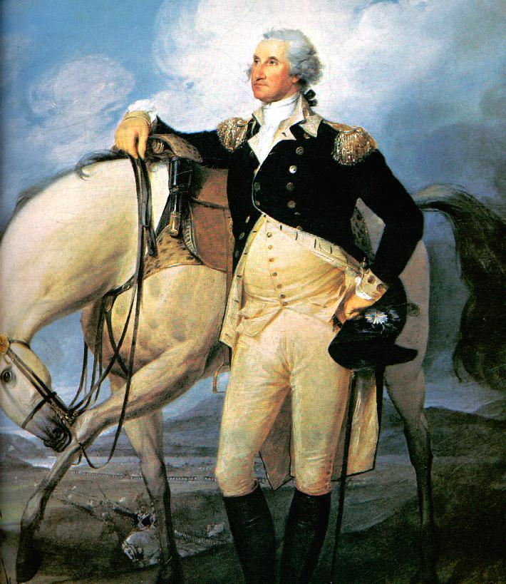
Commanders in Chief of the British and American Armies

Slide 22
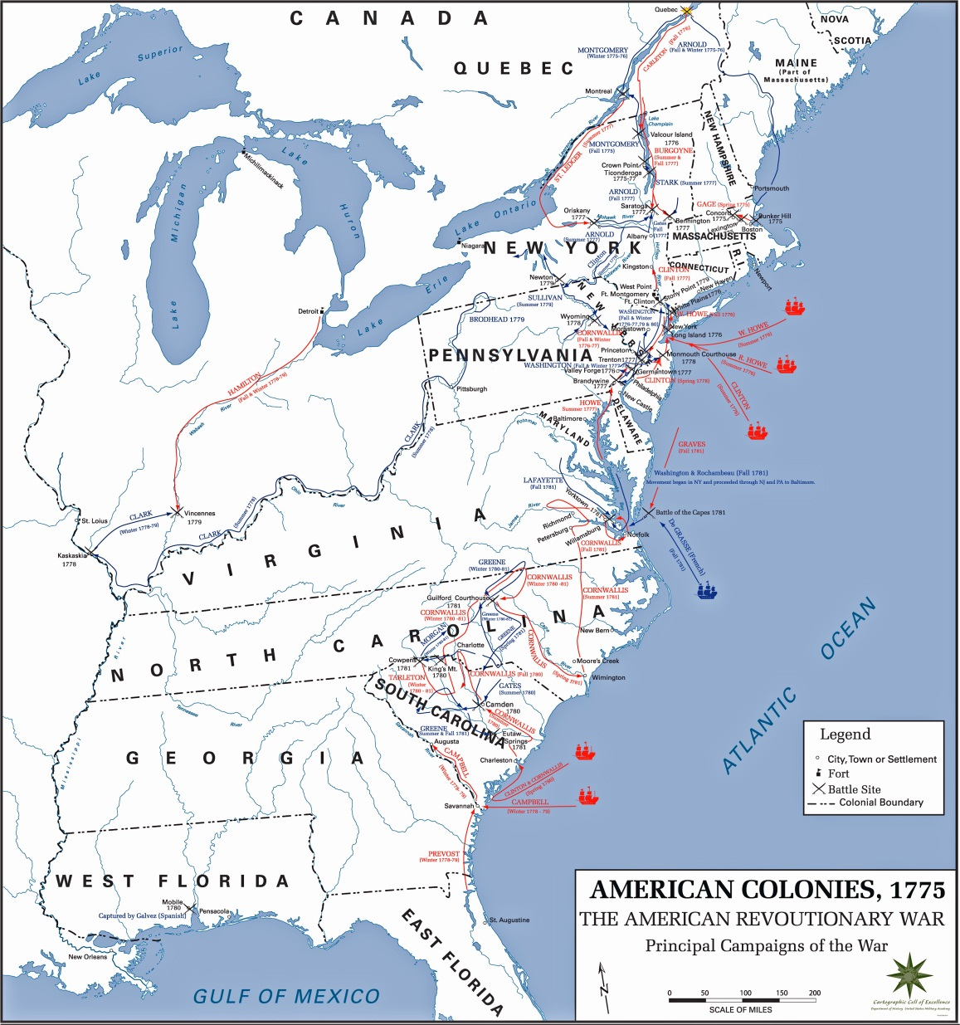
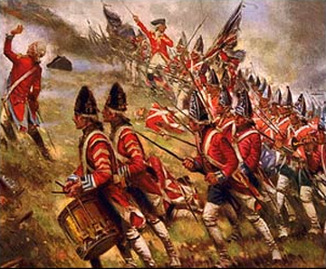

Slide 23
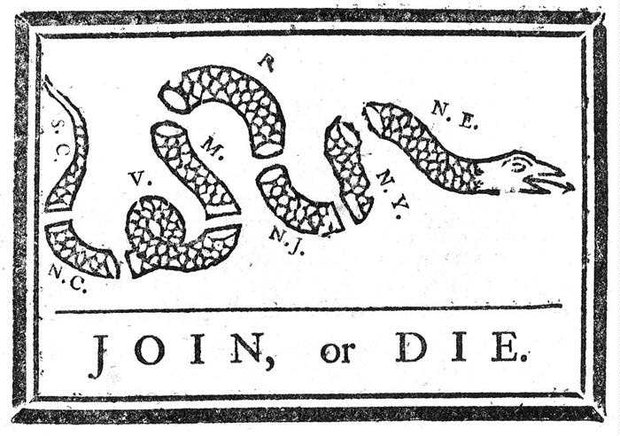

Slide 24
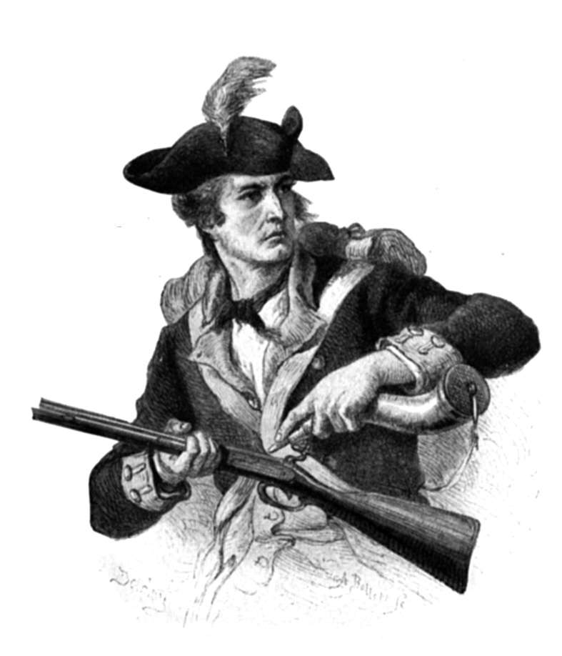
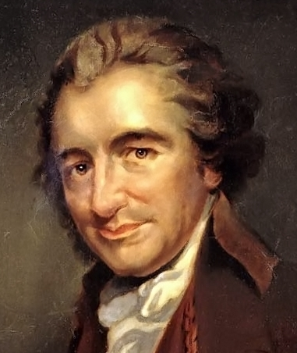
Freedom and the Common American

Slide 25
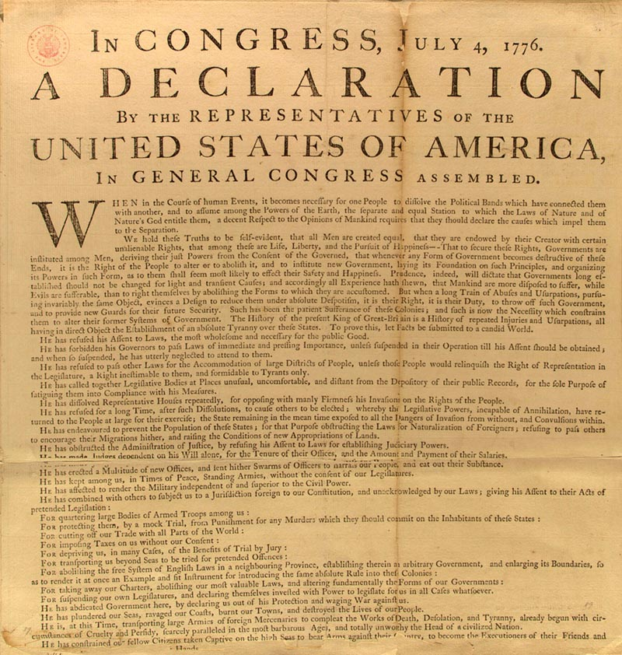
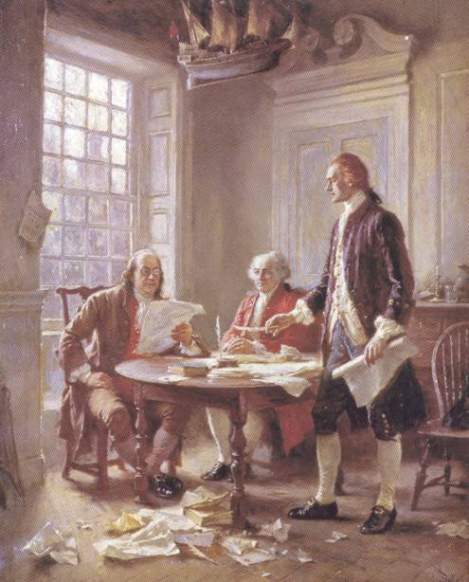
The Declaration of Independence

Slide 26
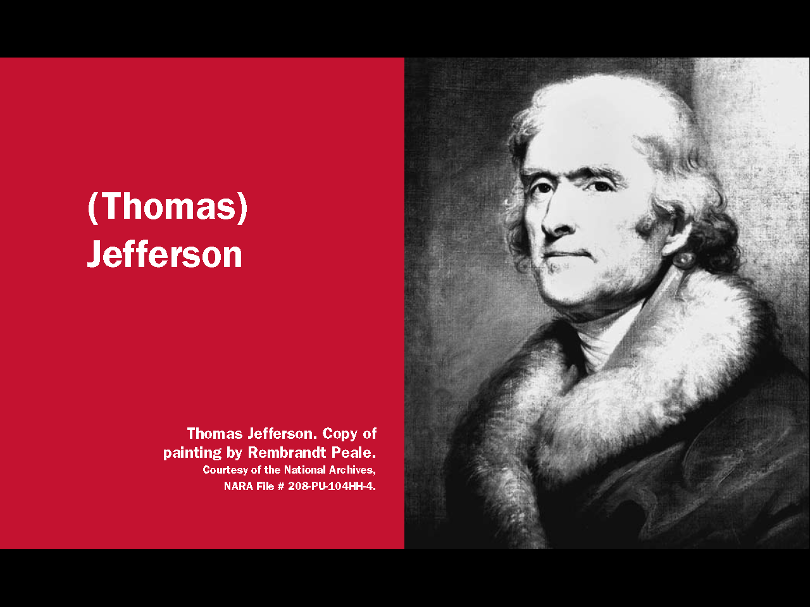
Question # 62

Slide 27
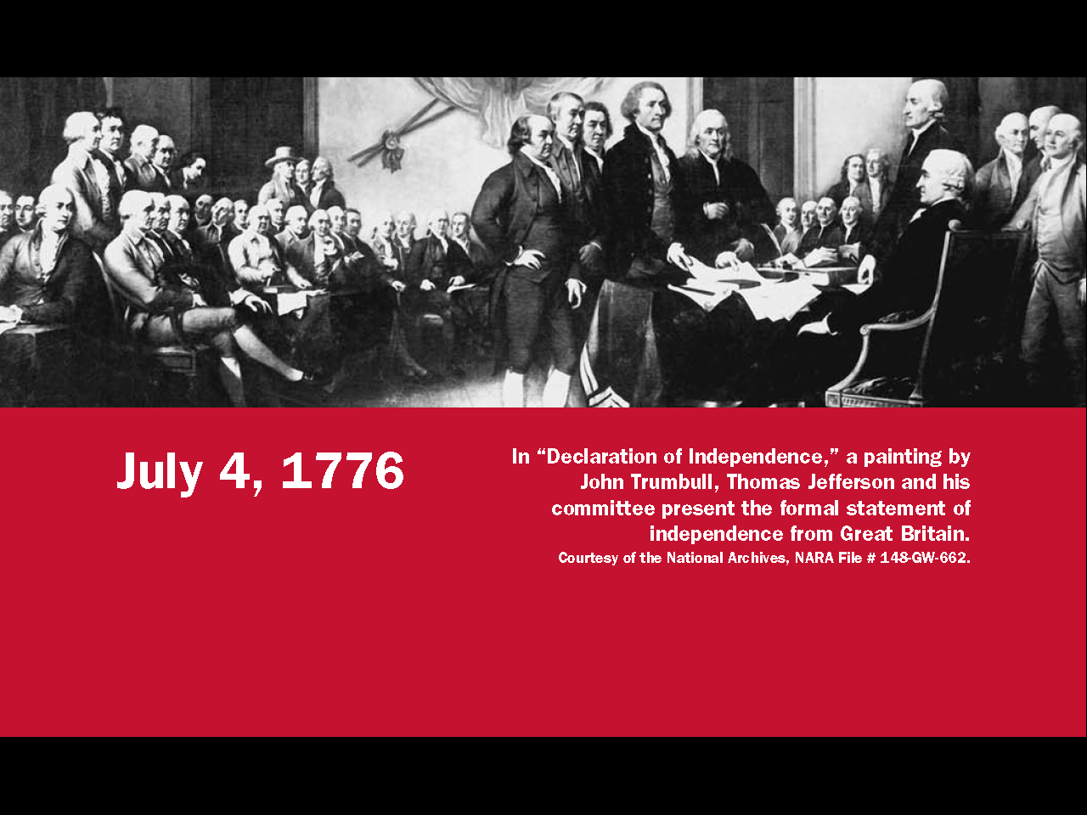
Question # 63

Slide 28
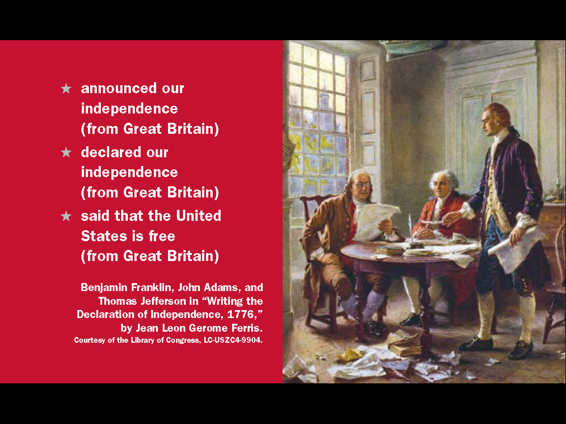
Question # 8

Slide 29

Question # 9

Slide 30
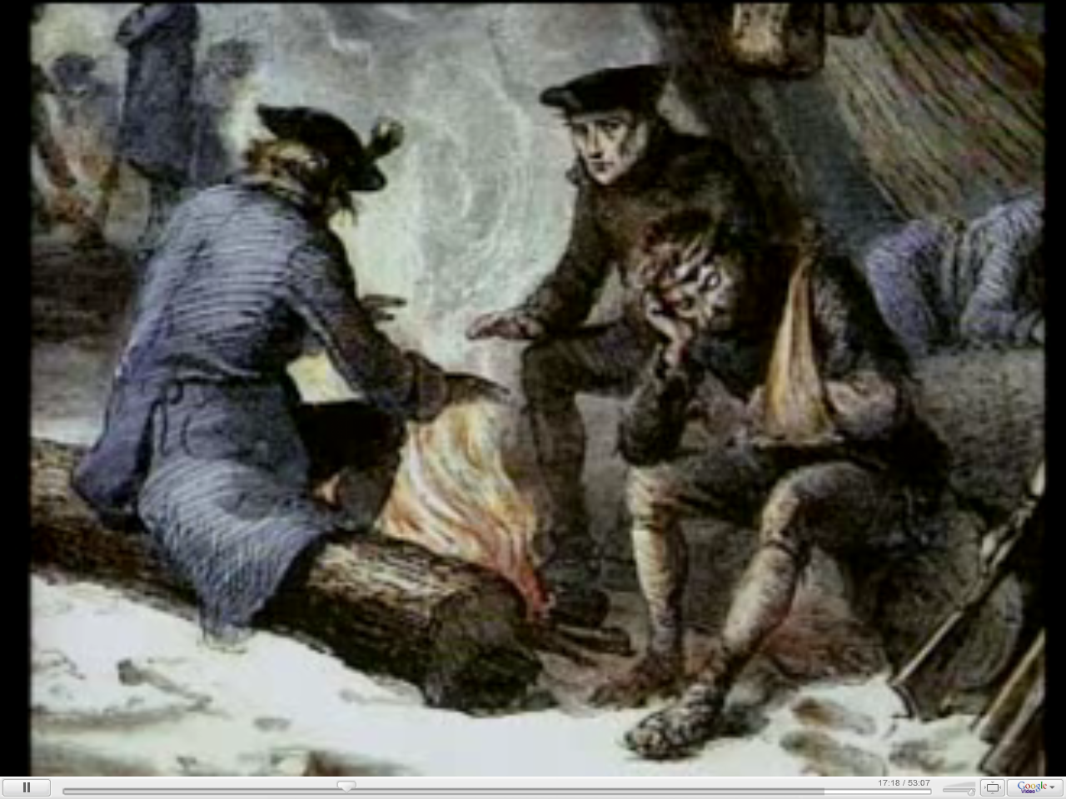

Slide 31

Question # 69 and 70

Slide 32
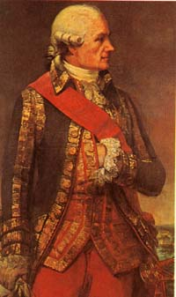
The French Join with the Americans

Slide 33
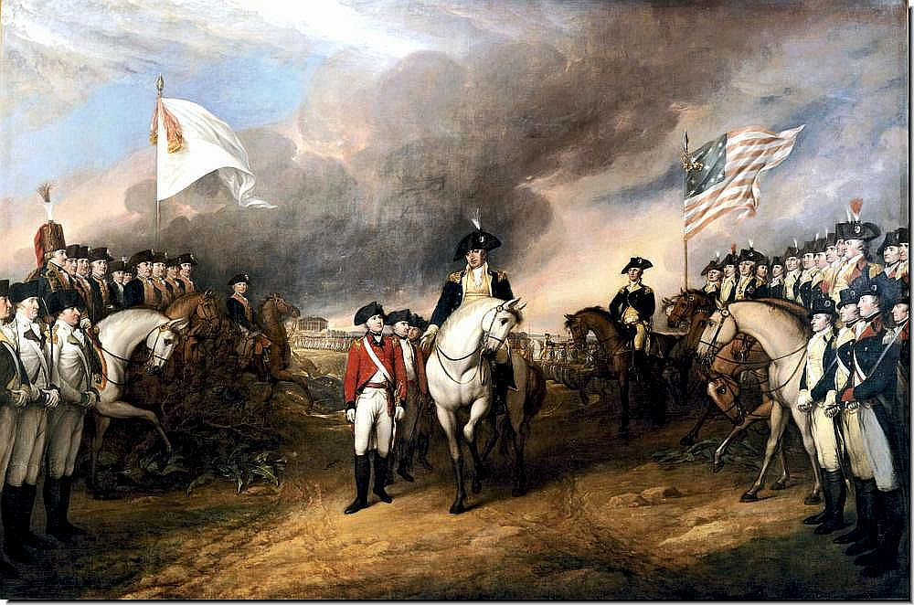

Slide 34
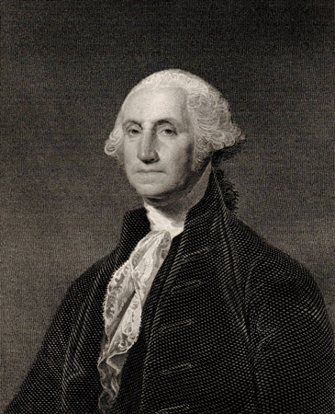
Question # 69 and 70

Slide 35
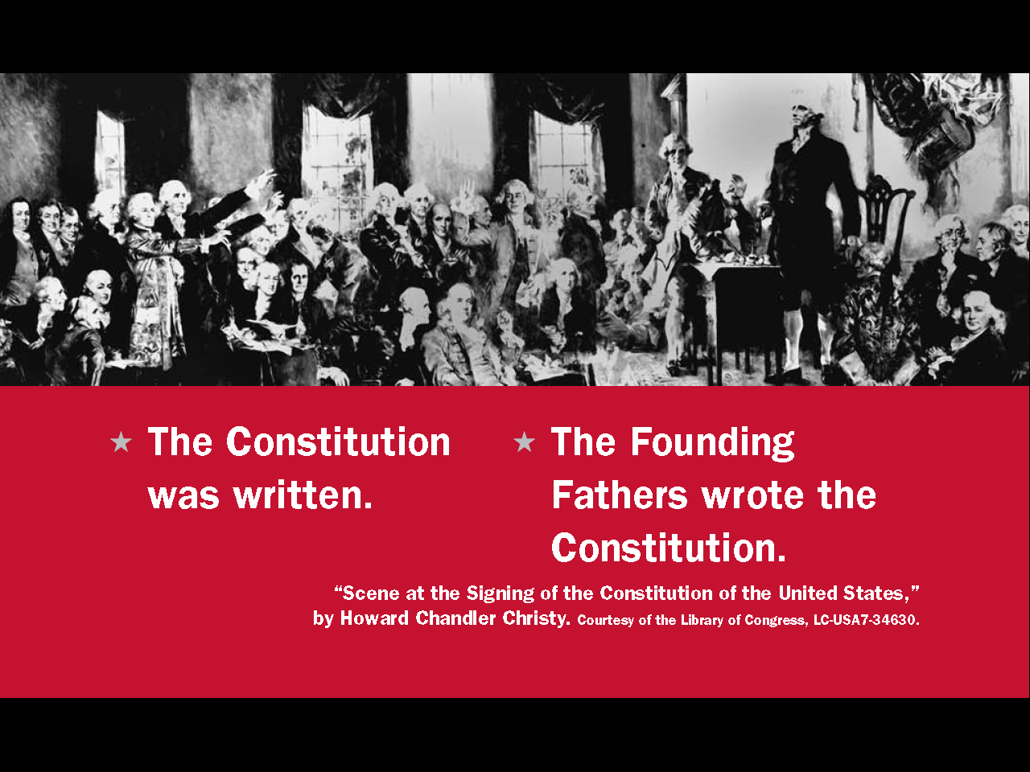
Question # 65

Slide 36
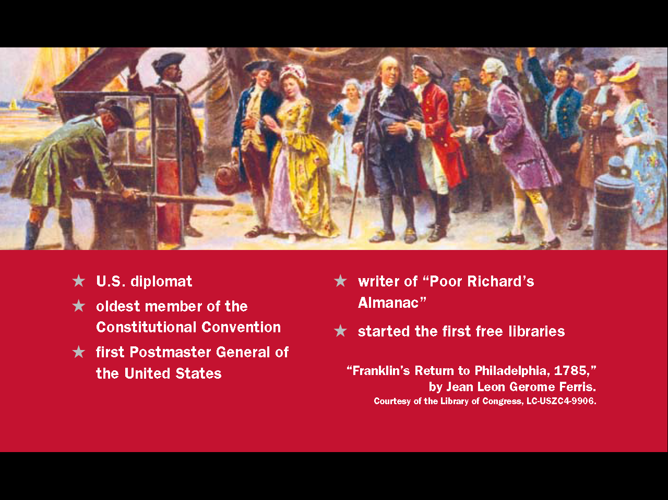
Question # 68

